Slide 1
Week 4:
Discrete Random Variables

Slide 2
OUTLINE
Definition of discrete random variable
Probability of discrete random variables
Important probability mass functions
Approximation of binomail PMF by Possion PMF
Transformation of discrete random variables
Cumulative distribution function
Computer simulation
Real world example – servicing customers

Slide 3
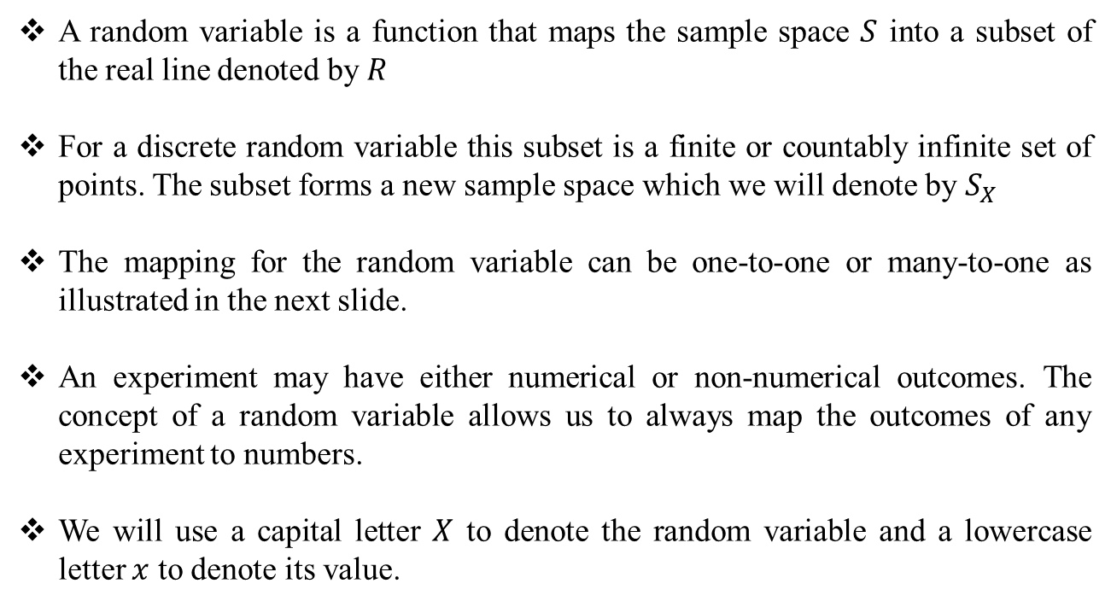
Definition of Discrete Random Variable
A random variable is a function that maps the sample space $S$ into a subset of the real line denoted by $R$
For a discrete random variable this subset is a finite or countably infinite set of points. The subset forms a new sample space which we will denote by $S_{X}$
The mapping for the random variable can be one-to-one or many-to-one as illustrated in the next slide.
An experiment may have either numerical or non-numerical outcomes. The concept of a random variable allows us to always map the outcomes of any experiment to numbers.
We will use a capital letter $X$ to denote the random variable and a lowercase letter $x$ to denote its value.

Slide 4
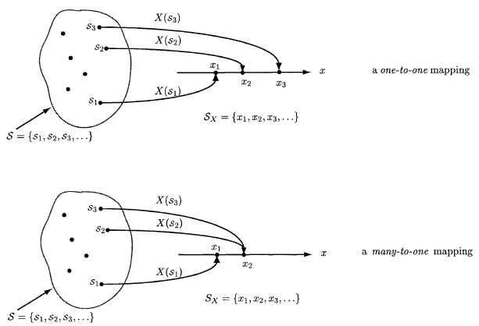
Definition of Discrete Random Variable
Figure source: S. M. Kay, Intuitive Probabilty and Random Processes Using MATLAB, Springer, 2006.

Slide 5
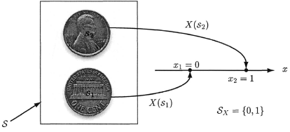
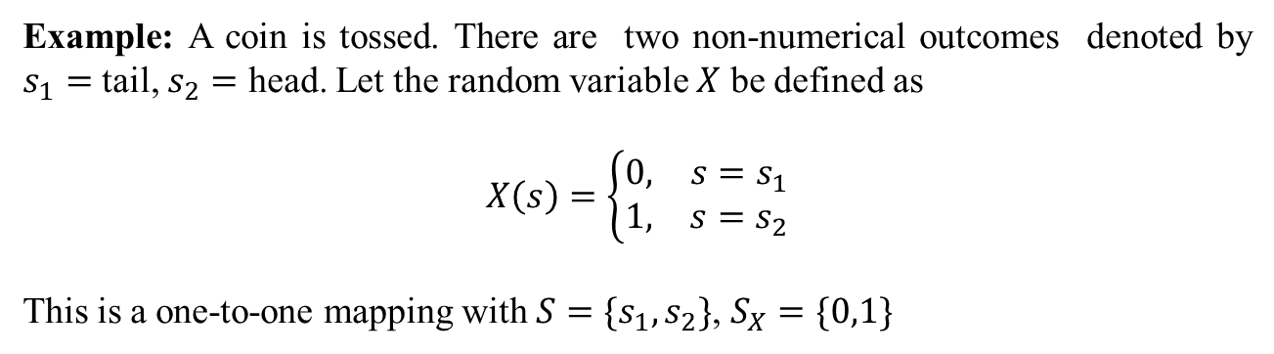
Definition of Discrete Random Variable
Example: A coin is tossed. There are two non-numerical outcomes denoted by $s_{1}=$ tail, $s_{2}=$ head. Let the random variable $X$ be defined as
$$X\left(s\right)=\left\{\begin{matrix}0, & s=s_{1} \\ 1, & s=s_{2}\end{matrix}\right.$$
This is a one-to-one mapping with $S=\{s_{1},s_{2}\}$, $S_{X}=\{0,1\}$
Figure source: S. M. Kay, Intuitive Probabilty and Random Processes Using MATLAB, Springer, 2006.

Slide 6
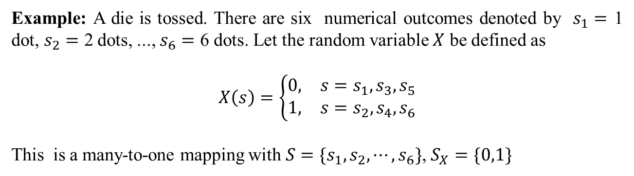
Definition of Discrete Random Variable
Example: A die is tossed. There are six numerical outcomes denoted by $s_{1}=$ 1 dot, $s_{2}=$ 2 dots, ..., $s_{6}=$ 6 dots. Let the random variable $X$ be defined as
$$X\left(s\right)=\left\{\begin{matrix}0, & s=s_{1},s_{3},s_{5} \\ 1, & s=s_{2},s_{4},s_{6}\end{matrix}\right.$$
This is a many-to-one mapping with $S=\{s_{1},s_{2},⋯,s_{6}\}$, $S_{X}=\{0,1\}$

Slide 7

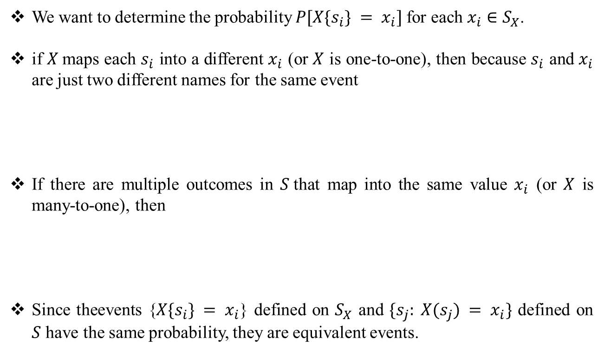
Probability of Discrete Random Variables
We want to determine the probability $P[X\{s_{i}\} = x_{i}]$for each $x_{i}∈S_{X}$.
if $X$maps each $s_{i}$ into a different $x_{i}$ (or $X$ is one-to-one), then because $s_{i}$ and $x_{i}$ are just two different names for the same event
If there are multiple outcomes in $S$that map into the same value $x_{i}$ (or $X$ is many-to-one), then
Since theevents {$X\{s_{i}\} = x_{i}$} defined on $S_{X}$ and $\{s_{j}: X(s_{j}) = x_{i}\}$ defined on $S$ have the same probability, they are equivalent events.

Slide 8

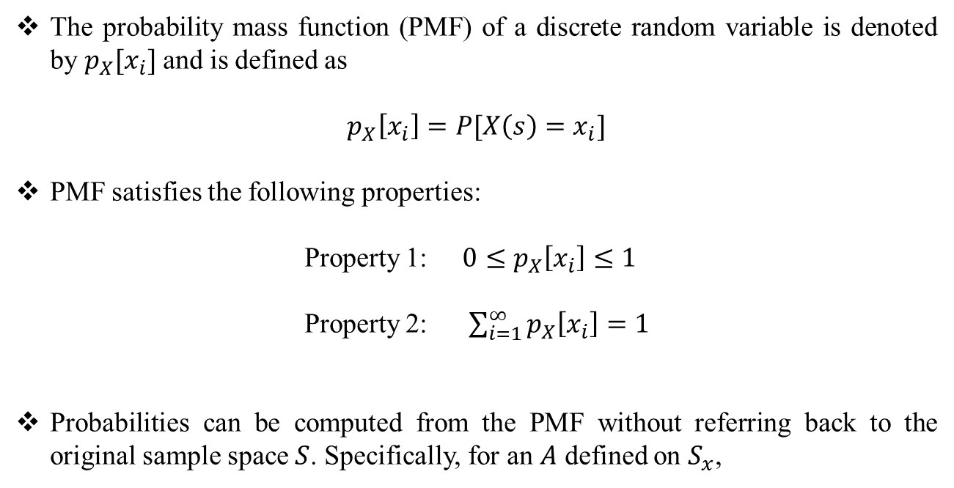
Probability of Discrete Random Variables
The probability mass function (PMF) of a discrete random variable is denoted by $p_{X}[x_{i}]$ and is defined as
$$p_{X}\left[x_{i}\right]=P[X\left(s\right)=x_{i}]$$
PMF satisfies the following properties:
Property 1: $0≤p_{X}\left[x_{i}\right]≤1$
Property 2: $\sum_{i=1}^{∞}{p_{X}\left[x_{i}\right]}=1$
Probabilities can be computed from the PMF without referring back to the original sample space $S$. Specifically, for an $A$ defined on $S_{x}$,

Slide 9

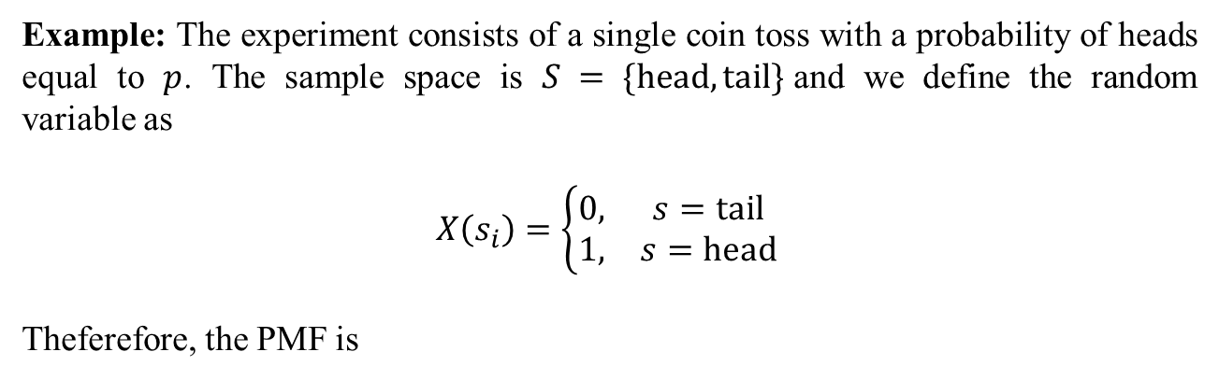
Definition of Discrete Random Variable
Example: The experiment consists of a single coin toss with a probability of heads equal to $p$. The sample space is $S = \{\text{head}, \text{tail}\}$and we define the random variable as
$$X\left(s_{i}\right)=\left\{\begin{matrix}0, & s=\text{tail} \\ 1, & s=\text{head} \end{matrix}\right.$$
Theferefore, the PMF is

Slide 10

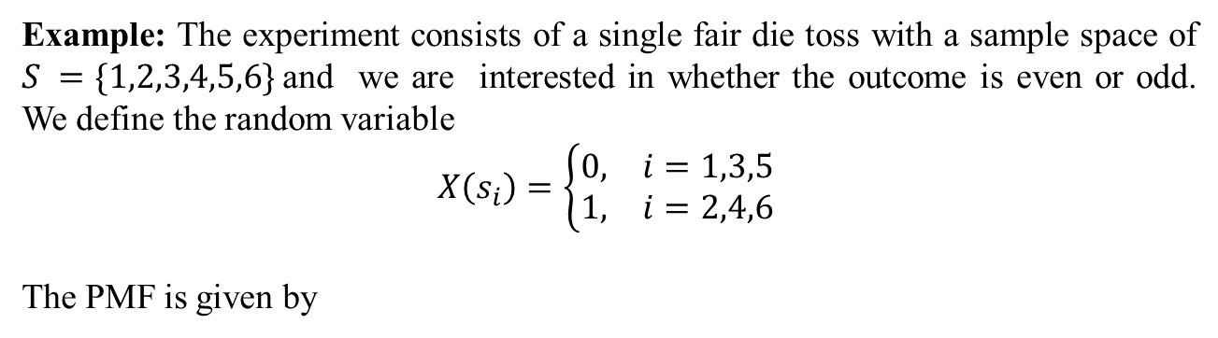
Definition of Discrete Random Variable
Example: The experiment consists of a single fair die toss with a sample space of $S =\{1,2,3,4,5,6\}$and we are interested in whether the outcome is even or odd. We define the random variable
$$X\left(s_{i}\right)=\left\{\begin{matrix}0, & i=1,3,5 \\ 1, & i=2,4,6 \end{matrix}\right.$$
The PMF is given by

Slide 11

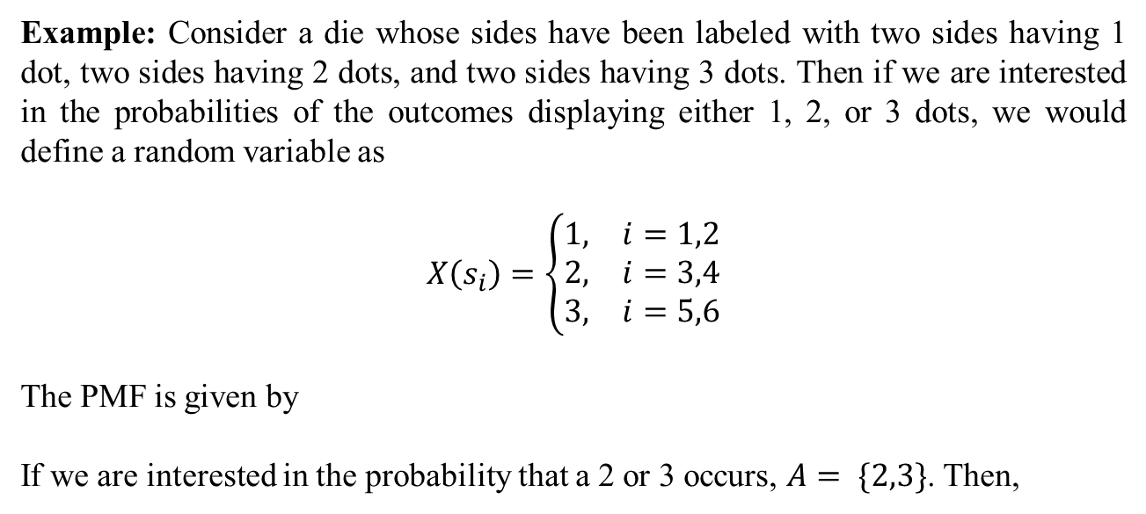
Definition of Discrete Random Variable
Example: Consider a die whose sides have been labeled with two sides having 1 dot, two sides having 2 dots, and two sides having 3 dots. Then if we are interested in the probabilities of the outcomes displaying either 1, 2, or 3 dots, we would define a random variable as
$$X\left(s_{i}\right)=\left\{\begin{matrix}1, & i=1,2 \\ 2, & i=3,4 \\ 3, & i=5,6\end{matrix}\right.$$
The PMF is given by
If we are interested in the probability that a 2 or 3 occurs, $A= \{2,3\}$. Then,

Slide 12
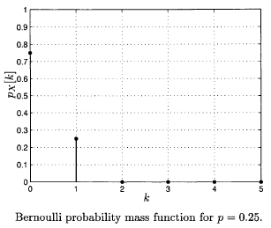
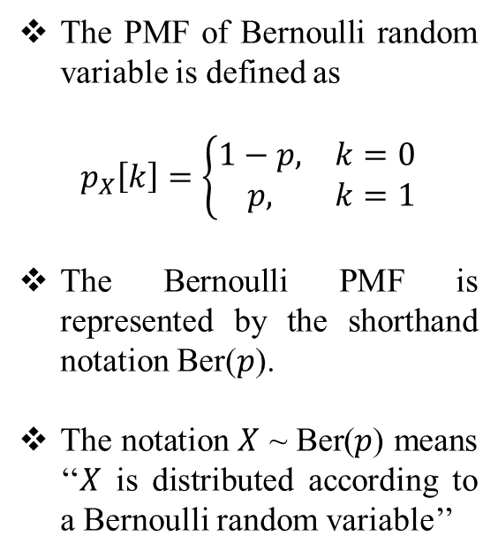
Important Probability Mass Functions
The PMF of Bernoulli random variable is defined as
$$p_{X}\left[k\right]=\left\{\begin{matrix}1−p, & k=0 \\ p, & k=1\end{matrix}\right.$$
The Bernoulli PMF is represented by the shorthand notation Ber($p$).
The notation $X$ ~ Ber($p$) means ‘‘$X$ is distributed according to a Bernoulli random variable’’
Figure source: S. M. Kay, Intuitive Probabilty and Random Processes Using MATLAB, Springer, 2006.

Slide 13
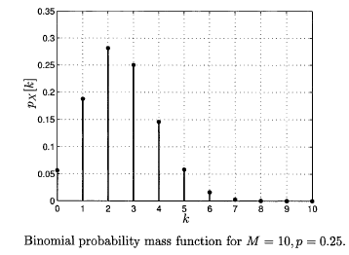
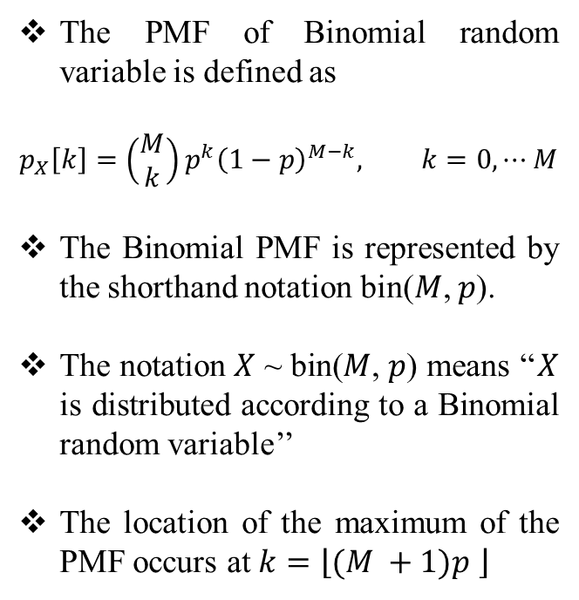
Important Probability Mass Functions
The PMF of Binomial random variable is defined as
$$p_{X}\left[k\right]=\left(\begin{matrix}M \\ k\end{matrix}\right)p^{k}{\left(1−p\right)}^{M−k}, k=0,⋯M$$
The Binomial PMF is represented by the shorthand notation bin($M$, $p$).
The notation $X$ ~ bin($M$, $p$) means ‘‘$X$ is distributed according to a Binomial random variable’’
The location of the maximum of the PMF occurs at $k=\left\lfloor (M +1)p \right\rfloor$
Figure source: S. M. Kay, Intuitive Probabilty and Random Processes Using MATLAB, Springer, 2006.

Slide 14
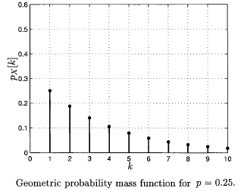
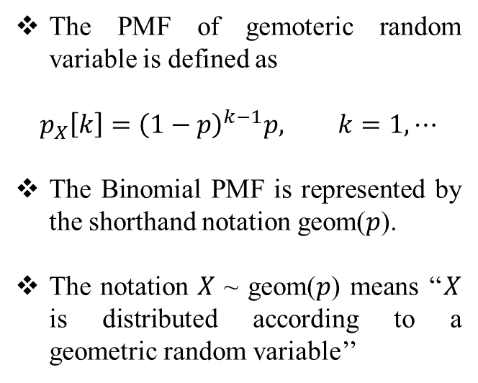
Important Probability Mass Functions
The PMF of gemoteric random variable is defined as
$$p_{X}\left[k\right]={\left(1−p\right)}^{k−1}p, k=1,⋯$$
The Binomial PMF is represented by the shorthand notation geom($p$).
The notation $X$ ~ geom($p$) means ‘‘$X$ is distributed according to a geometric random variable’’
Figure source: S. M. Kay, Intuitive Probabilty and Random Processes Using MATLAB, Springer, 2006.

Slide 15
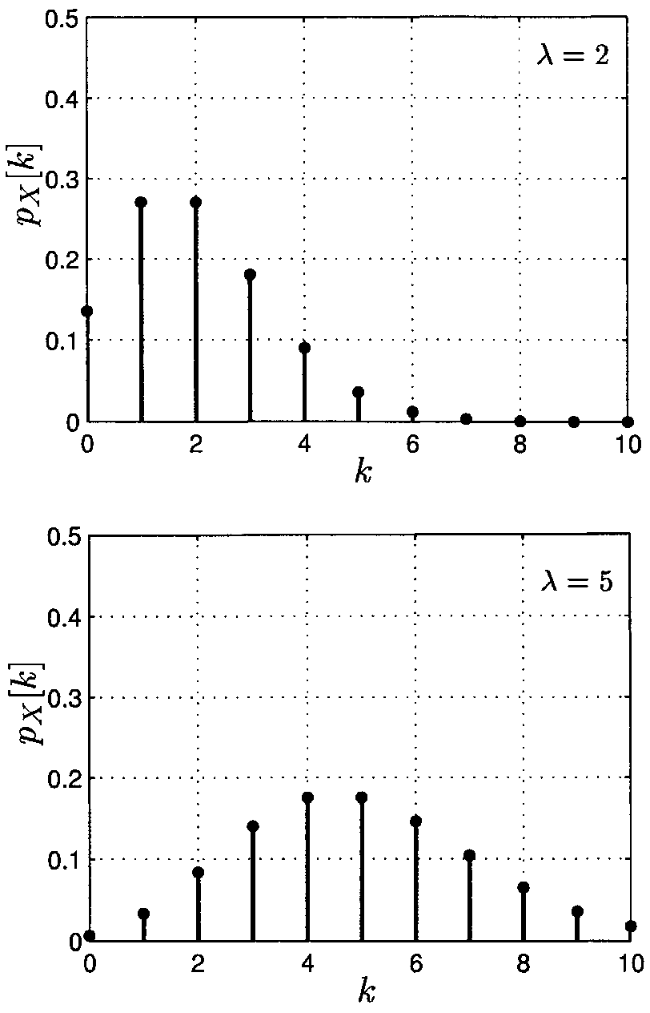
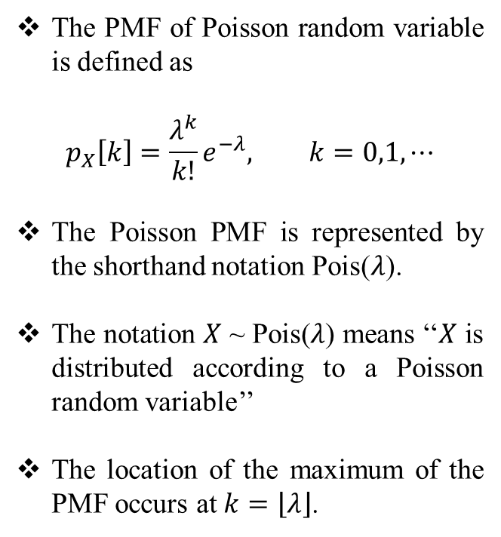
Important Probability Mass Functions
The PMF of Poisson random variable is defined as
$$p_{X}\left[k\right]=\frac{λ^{k}}{k!}e^{−λ}, k=0,1,⋯$$
The Poisson PMF is represented by the shorthand notation Pois($λ$).
The notation $X$ ~ Pois($λ$) means ‘‘$X$ is distributed according to a Poisson random variable’’
The location of the maximum of the PMF occurs at $k=\left\lfloor λ\right\rfloor$.
Figure source: S. M. Kay, Intuitive Probabilty and Random Processes Using MATLAB, Springer, 2006.

Slide 16
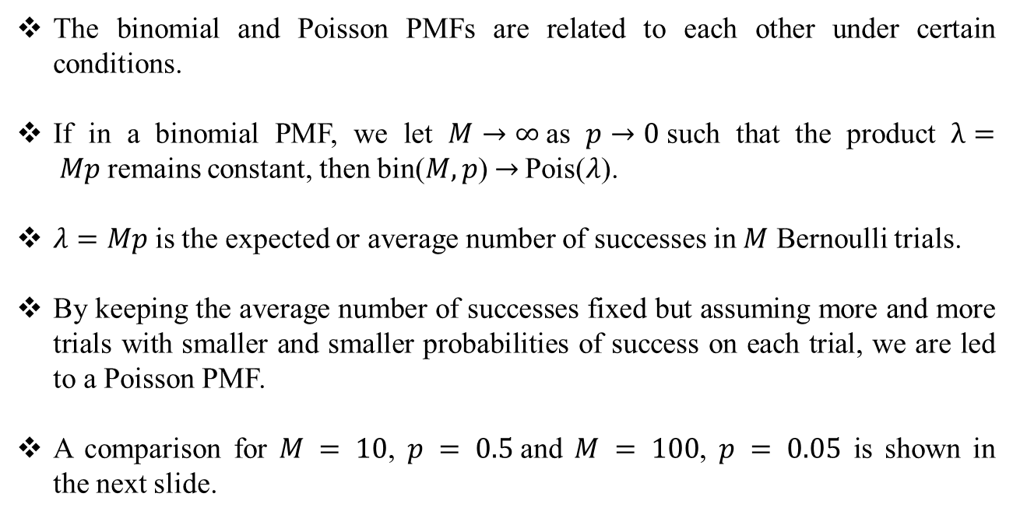
Important Probability Mass Functions
The binomial and Poisson PMFs are related to each other under certain conditions.
If in a binomial PMF, we let $M→∞$as $p→0$such that the product $λ= Mp$remains constant, then bin($M,p$)$→$ Pois($λ$).
$λ=Mp$is the expected or average number of successes in $M$ Bernoulli trials.
By keeping the average number of successes fixed but assuming more and more trials with smaller and smaller probabilities of success on each trial, we are led to a Poisson PMF.
A comparison for $M = 10$, $p = 0.5$and $M = 100$, $p = 0.05$ is shown in the next slide.

Slide 17
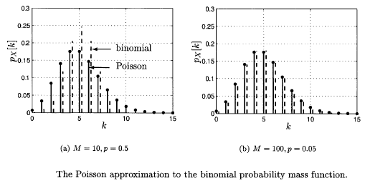
Important Probability Mass Functions
Figure source: S. M. Kay, Intuitive Probabilty and Random Processes Using MATLAB, Springer, 2006.

Slide 18
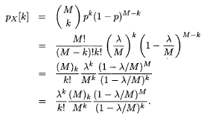
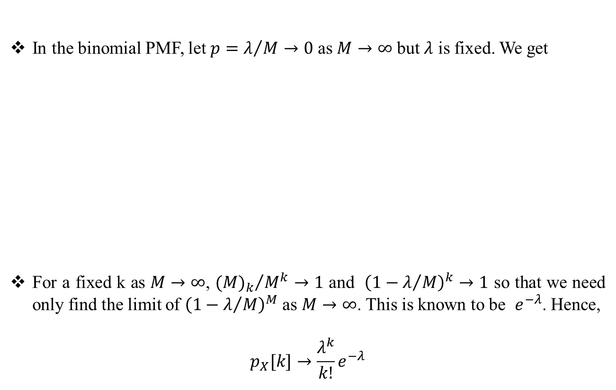
Important Probability Mass Functions
In the binomial PMF, let $p=λ/M→0$ as $M→∞$ but $λ$ is fixed. We get
For a fixed k as $M→∞$, ${{(M)}_{k}}/{M^{k}→1}$ and ${\left(1−λ/M\right)}^{k}→1$ so that we need only find the limit of ${\left(1−λ/M\right)}^{M}$ as $M→∞$. This is known to be $e^{−λ}$. Hence,
$$p_{X}[k]→\frac{λ^{k}}{k!}e^{−λ}$$

Slide 19
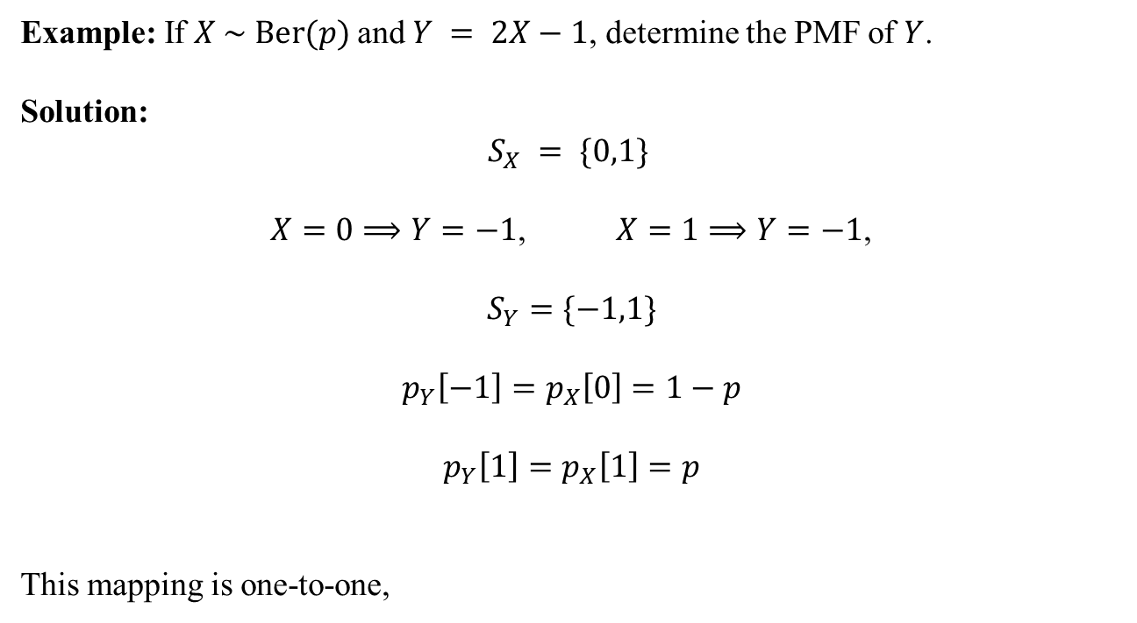
Transformations of Discrete Random Variables
Example: If $X \sim \text{Ber}(p)$and $Y = 2X−1$, determine the PMF of $Y$.
Solution:
$$S_{X} = \{0,1\}$$
$X=0⟹Y=−1$, $X=1⟹Y=−1$,
$$S_{Y}=\{−1,1\}$$
$$p_{Y}\left[−1\right]=p_{X}\left[0\right]=1−p$$
$$p_{Y}\left[1\right]=p_{X}\left[1\right]=p$$
This mapping is one-to-one,

Slide 20
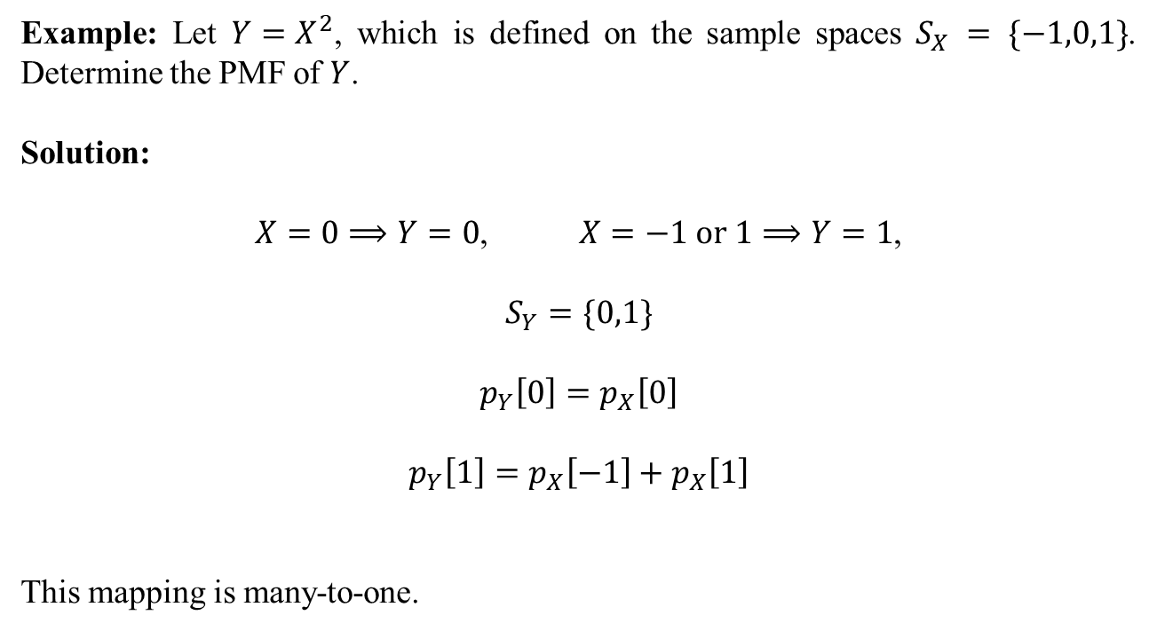
Transformations of Discrete Random Variables
Example: Let $Y=X^{2}$, which is defined on the sample spaces $S_{X} = \{−1,0,1\}$. Determine the PMF of $Y$.
Solution:
$X=0⟹Y=0$, $X=−1 \text{or} 1⟹Y=1$,
$$S_{Y}=\{0,1\}$$
$$p_{Y}\left[0\right]=p_{X}\left[0\right]$$
$$p_{Y}\left[1\right]=p_{X}\left[−1\right]+p_{X}\left[1\right]$$
This mapping is many-to-one.

Slide 21

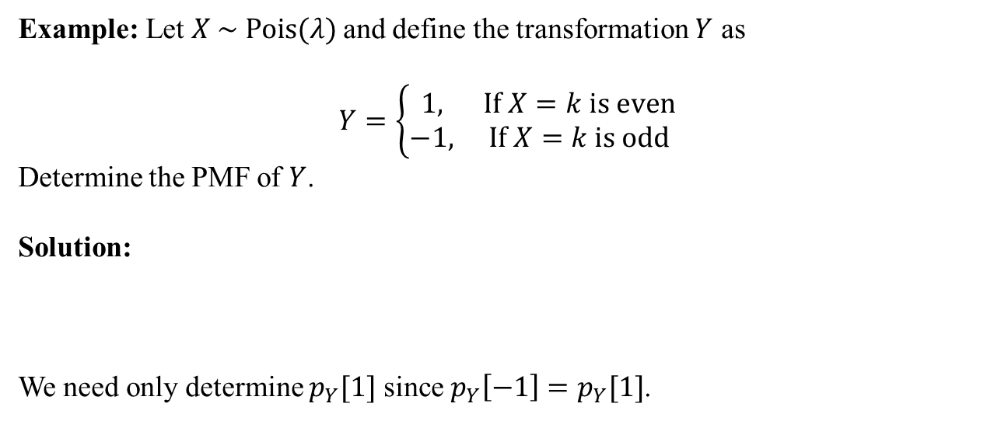
Transformations of Discrete Random Variables
Example: Let $X \sim \text{Pois}(λ)$and define the transformation $Y$ as
$$Y=\left\{\begin{matrix}1, & \text{If} X=k \text{is} \text{even} \\ −1, & \text{If} X=k \text{is} \text{odd}\end{matrix}\right.$$
Determine the PMF of $Y$.
Solution:
We need only determine $p_{Y}[1]$ since $p_{Y}\left[−1\right]=p_{Y}[1]$.

Slide 22


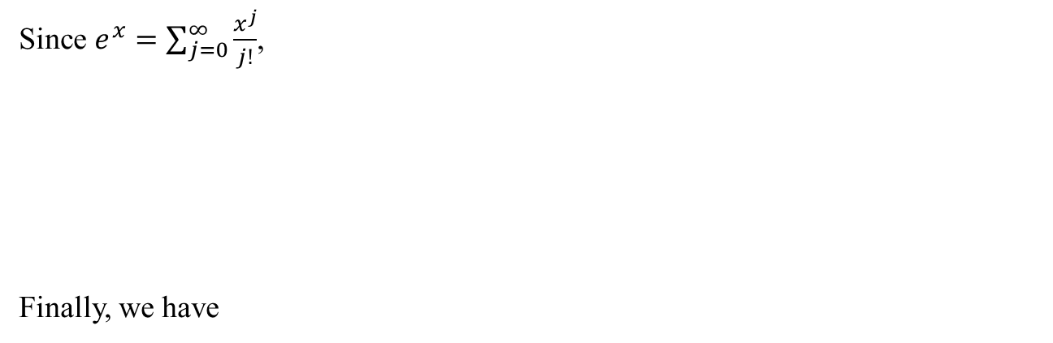
Transformations of Discrete Random Variables
Since $e^{x}=\sum_{j=0}^{∞}{\frac{x^{j}}{j!}}$,
Finally, we have

Slide 23
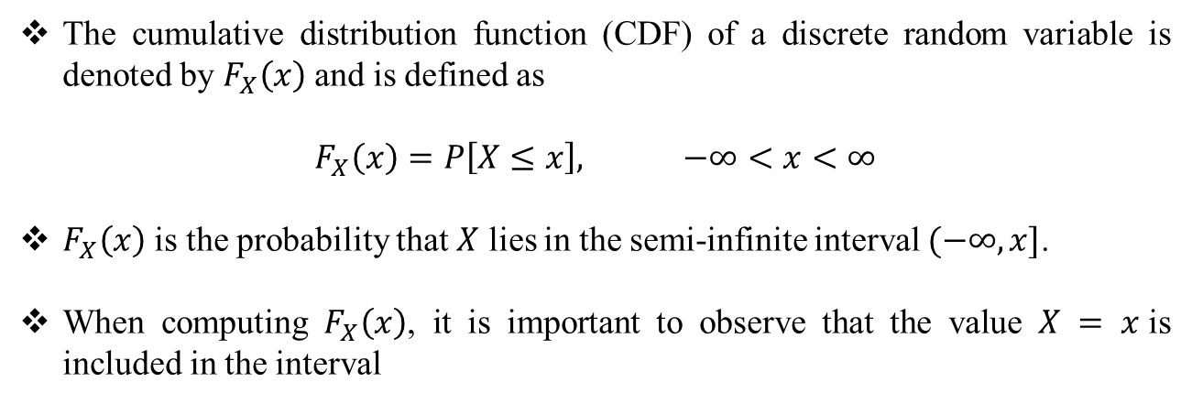
Cumulative Distribution Function
The cumulative distribution function (CDF) of a discrete random variable is denoted by $F_{X}\left(x\right)$ and is defined as
$$F_{X}\left(x\right)=P\left[X≤x\right], −∞<x<∞$$
$F_{X}\left(x\right)$ is the probability that $X$ lies in the semi-infinite interval $(−∞,x]$.
When computing $F_{X}\left(x\right)$, it is important to observe that the value $X = x$is included in the interval

Slide 24
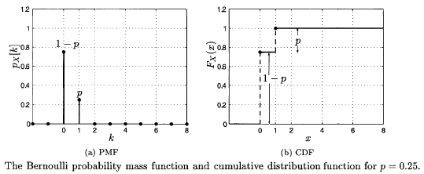
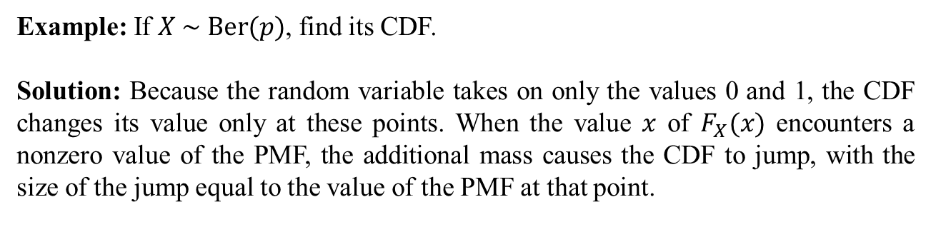
Cumulative Distribution Function
Example: If $X \sim \text{Ber}(p)$, find its CDF.
Solution: Because the random variable takes on only the values 0 and 1, the CDF changes its value only at these points. When the value $x$ of $F_{X}(x)$ encounters a nonzero value of the PMF, the additional mass causes the CDF to jump, with the size of the jump equal to the value of the PMF at that point.
Figure source: S. M. Kay, Intuitive Probabilty and Random Processes Using MATLAB, Springer, 2006.

Slide 25

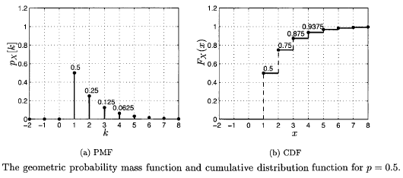
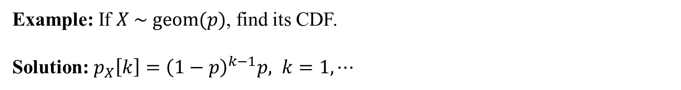
Cumulative Distribution Function
Example: If $X \sim \text{geom}(p)$, find its CDF.
Solution: $p_{X}\left[k\right]={\left(1−p\right)}^{k−1}p, k=1,⋯$
Figure source: S. M. Kay, Intuitive Probabilty and Random Processes Using MATLAB, Springer, 2006.

Slide 26
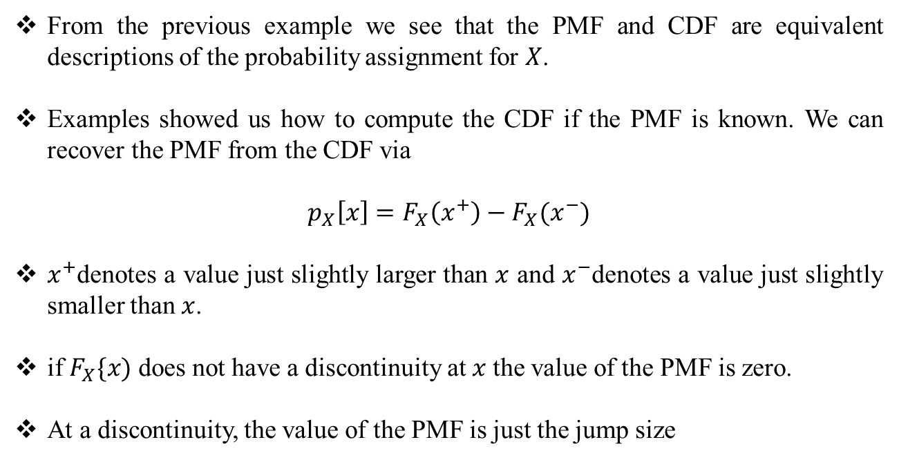
Cumulative Distribution Function
From the previous example we see that the PMF and CDF are equivalent descriptions of the probability assignment for $X$.
Examples showed us how to compute the CDF if the PMF is known. We can recover the PMF from the CDF via
$$p_{X}\left[x\right]=F_{X}\left(x^{+}\right)−F_{X}(x^{−})$$
$x^{+}$denotes a value just slightly larger than $x$ and $x^{−}$denotes a value just slightly smaller than $x$.
if $F_{X}\{x)$ does not have a discontinuity at $x$the value of the PMF is zero.
At a discontinuity, the value of the PMF is just the jump size

Slide 27


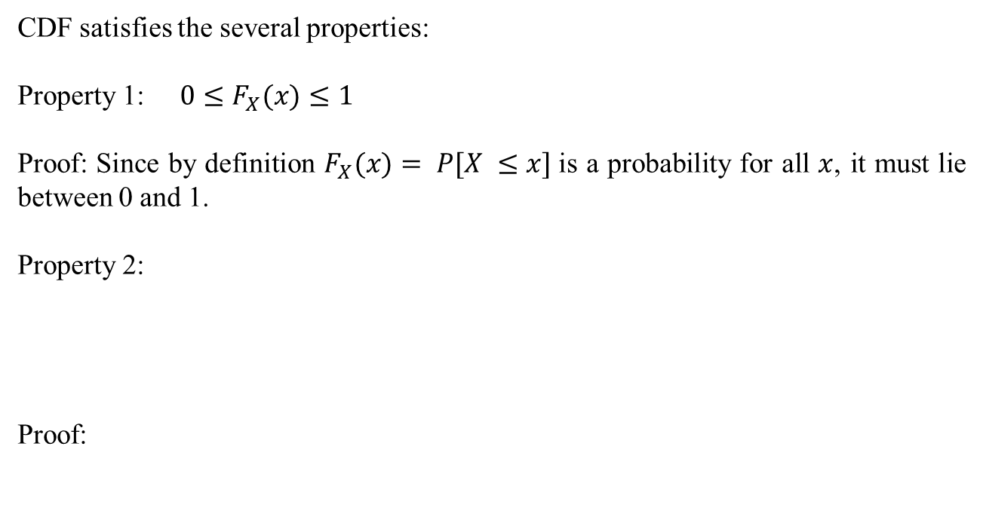
Cumulative Distribution Function
CDF satisfies the several properties:
Property 1: $0≤F_{X}(x)≤1$
Proof: Since by definition $F_{X}(x)= P[X ≤x]$is a probability for all $x$, it must lie between 0 and 1.
Property 2:
Proof:

Slide 28


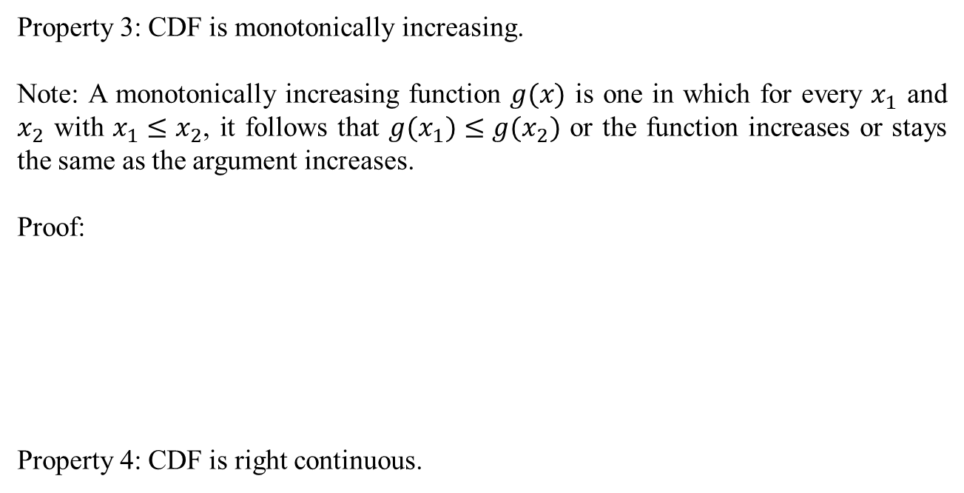
Cumulative Distribution Function
Property 3: CDF is monotonically increasing.
Note: A monotonically increasing function $g(x)$ is one in which for every $x_{1}$ and $x_{2}$ with $x_{1}≤x_{2}$, it follows that ${g(x}_{1})≤{g(x}_{2})$ or the function increases or stays the same as the argument increases.
Proof:
Property 4: CDF is right continuous.

Slide 29
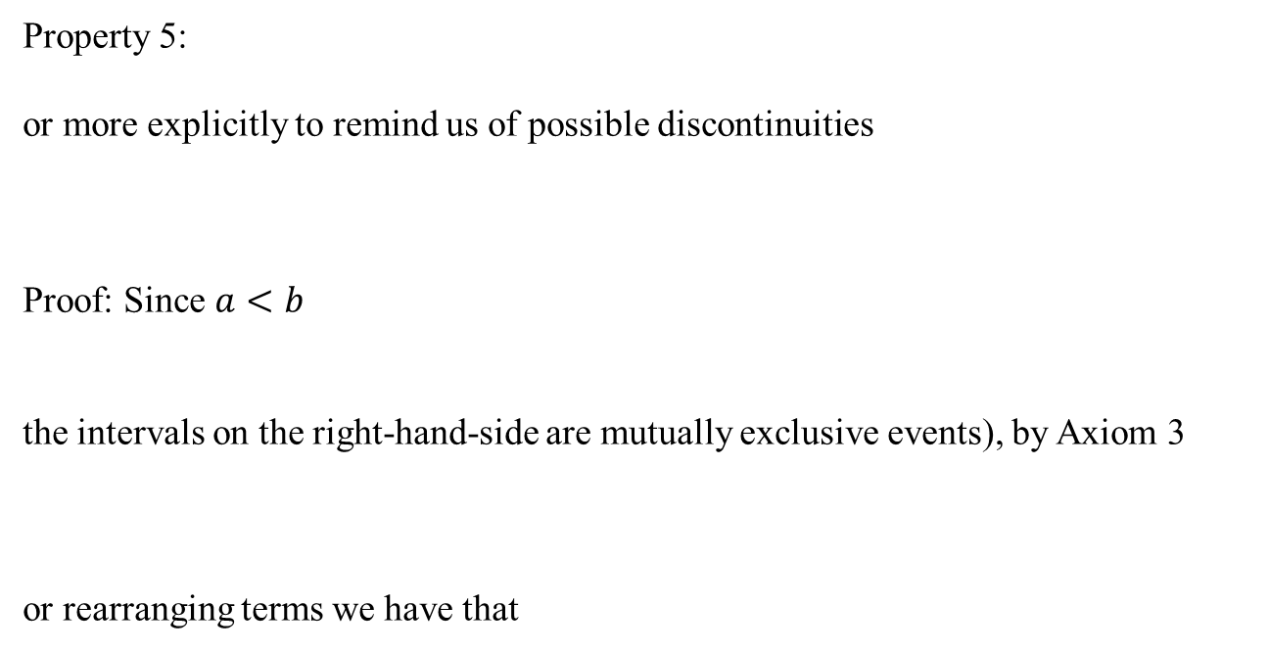
Cumulative Distribution Function
Property 5:
or more explicitly to remind us of possible discontinuities
Proof: Since $a<b$
the intervals on the right-hand-side are mutually exclusive events), by Axiom 3
or rearranging terms we have that

Slide 30
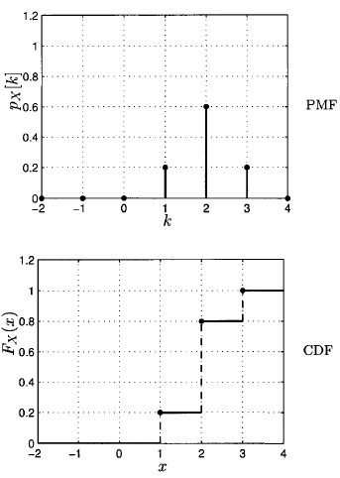
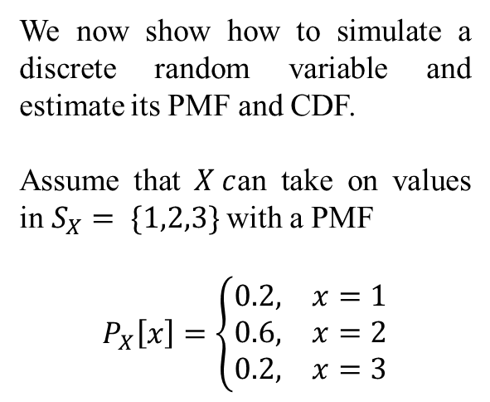
Computer Simulation
We now show how to simulate a discrete random variable and estimate its PMF and CDF.
Assume that $X c$an take on values in $S_{X}= \{1,2,3\}$with a PMF
$$P_{X}\left[x\right]=\left\{\begin{matrix}0.2, & x=1 \\ 0.6, & x=2 \\ 0.2, & x=3\end{matrix}\right.$$
Figure source: S. M. Kay, Intuitive Probabilty and Random Processes Using MATLAB, Springer, 2006.

Slide 31
Computer Simulation
M = 100;
x = zeros(M,1);
x1 = 1;
x2 = 2;
x3 = 3;
p1 = 0.2;
p2 = 0.6;
for i = 1:M
u = rand(1,1);
if u <= p1
x(i,1) = x1;
elseif u <= (p1+p2)
x(i,1) = x2;
elseif u > (p1+p2)
x(i,1) = x3;
end
end

Slide 32
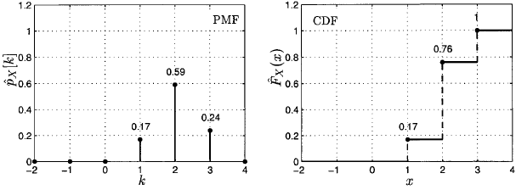

Computer Simulation
Figure source: S. M. Kay, Intuitive Probabilty and Random Processes Using MATLAB, Springer, 2006.

Slide 33
Real World Example – Servicing Customers
Example:
A supermarket has one express lane open from 5 to 6 PM on weekdays. The average time to process an order is 1 minute.
The manager is reluctant to open more lanes than necessary. The manager hires you to study the problem. The manager tells you there should be no more than one person waiting in line 95% of the time. The arrival rate is 1.167 customers per minute (or 70 customers in the 5 to 6 PM interval).
Your job is to find how many lanes should be opened.

Slide 34
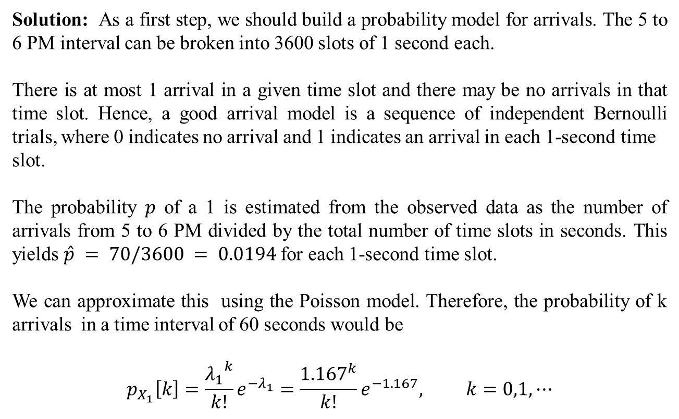
Real World Example – Servicing Customers
Solution: As a first step, we should build a probability model for arrivals. The 5 to 6 PM interval can be broken into 3600 slots of 1 second each.
There is at most 1 arrival in a given time slot and there may be no arrivals in that time slot. Hence, a good arrival model is a sequence of independent Bernoulli trials, where 0 indicates no arrival and 1 indicates an arrival in each 1-second time
slot.
The probability $p$ of a 1 is estimated from the observed data as the number of arrivals from 5 to 6 PM divided by the total number of time slots in seconds. This yields $\hat{p} = 70/3600 = 0.0194$for each 1-second time slot.
We can approximate this using the Poisson model. Therefore, the probability of k arrivals in a time interval of 60 seconds would be
$$p_{X_{1}}\left[k\right]=\frac{{λ_{1}}^{k}}{k!}e^{−λ_{1}}=\frac{{1.167}^{k}}{k!}e^{−1.167}, k=0,1,⋯$$

Slide 35

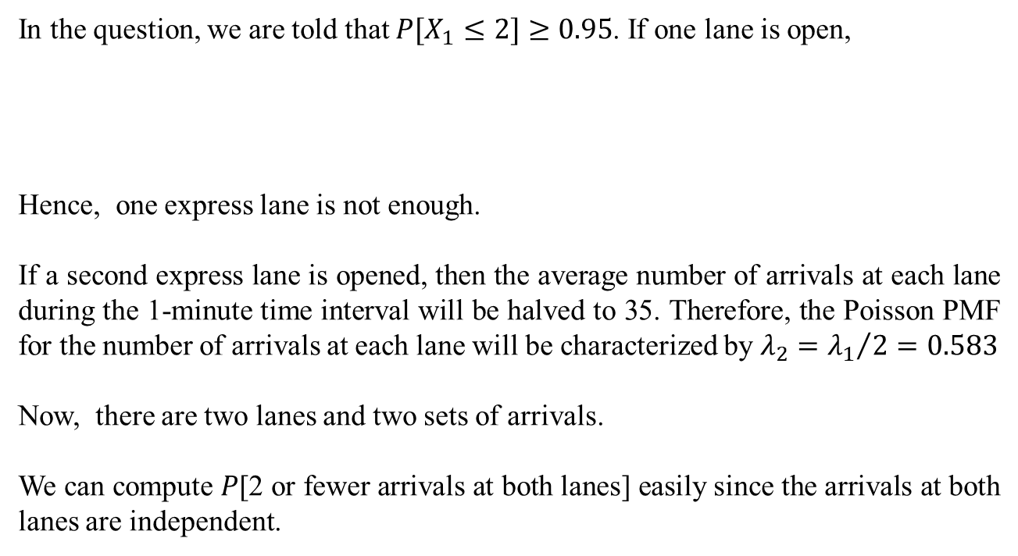
Real World Example – Servicing Customers
In the question, we are told that $P[X_{1}≤2]≥0.95$. If one lane is open,
Hence, one express lane is not enough.
If a second express lane is opened, then the average number of arrivals at each lane during the 1-minute time interval will be halved to 35. Therefore, the Poisson PMF for the number of arrivals at each lane will be characterized by $λ_{2}={λ_{1}}/2=0.583$
Now, there are two lanes and two sets of arrivals.
We can compute $P$[2 or fewer arrivals at both lanes] easily since the arrivals at both lanes are independent.

Slide 36
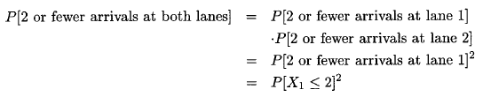
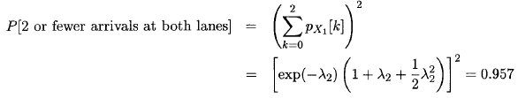
Real World Example – Servicing Customers
Hence, two express lanes are enough.

Slide 37
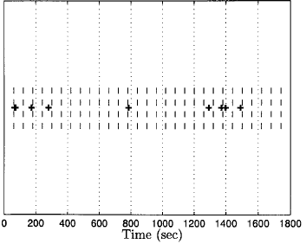
Real World Example – Servicing Customers
An example is shown for one of the two express lanes
The dashed vertical lines indicate 1-minute intervals.
Note that there are no 1-minute intervals with more than 2 arrivals.
Figure source: S. M. Kay, Intuitive Probabilty and Random Processes Using MATLAB, Springer, 2006.

